Slide 1
Веб разработка

Slide 2
Зачем мне веб разработка?
1. Программирование - это не решение школьных задач на Pascal, C#, C++
2. Сайты наиболее популярные IT продукты
3. Многие IT Продукты интегрированы с сайтами

Slide 3
Конкурсы профессионального мастерства
WORLDSKILLS
Конкурс для молодежи до 21 года
Компетенция:
Веб дизайн и разработка
АБИЛИМПИКС
Конкурс для лиц с инвалидностью и ОВЗ без возрастных ограничений
Компетенции:
Веб-дизайн
Веб-разработка (программирование)

Slide 4
Веб-разработка
Fullstack
Процесс создания веб-сайта или веб-приложения
- вёрстка страниц и программирование на стороне клиента (frontend)
- программирование на стороне сервера и конфигурирование веб-сервера (backend)

Slide 5
Что будем изучать?
Frontend
HTML
CSS
JavaScript
Backend
PHP
MySQL
CMS WordPress
Хостинг и публикация

Slide 6
ПО
Google Chrome / Яндекс браузер https://www.google.ru/chrome/
PhpStorm https://www.jetbrains.com/ru-ru/phpstorm/
Код Visual Studio https://azure.microsoft.com/ru-ru/products/visual-studio-code/
Open Server https://ospanel.io/

Slide 7
Frontend

Slide 8

HTML
HTML - это язык разметки
Разметка производится «ТЕГАМИ»
Теги заключаются в треугольные скобки

Slide 9
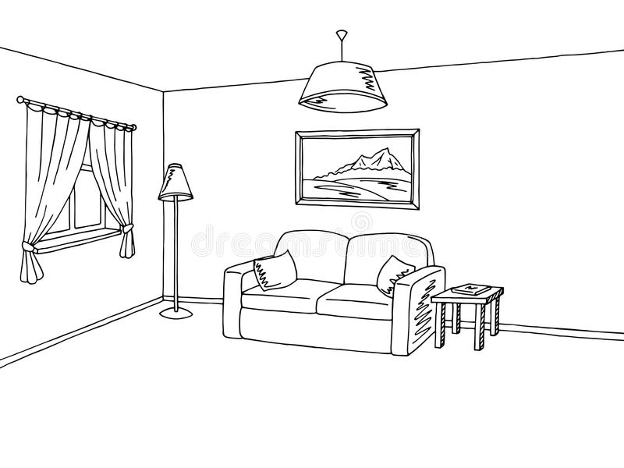
HTML

Slide 10
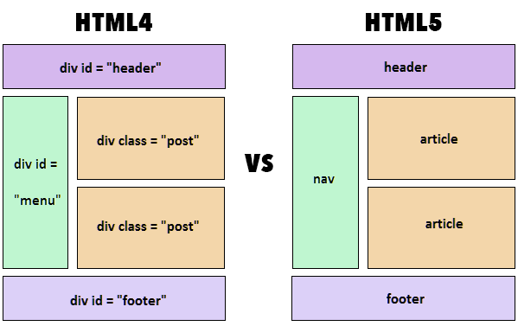
HTML
Here you have a list of items
And some text
But remember not to overload your slides with content
Your audience will listen to you or read the content, but won’t do both.

Slide 11
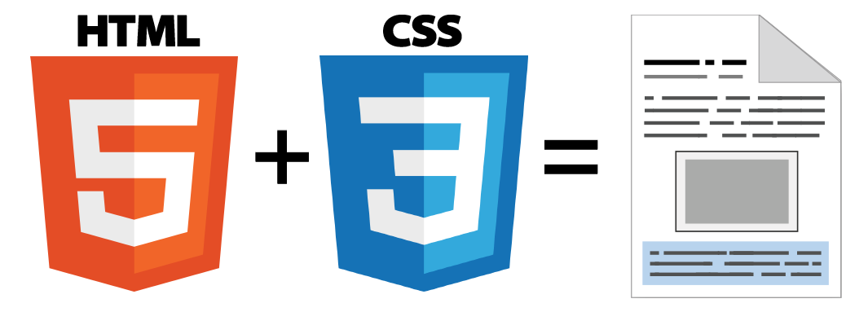
CSS
CSS - язык таблиц стилей
Позволяет преобразовать (приукрасить) внешний вид страницы

Slide 12
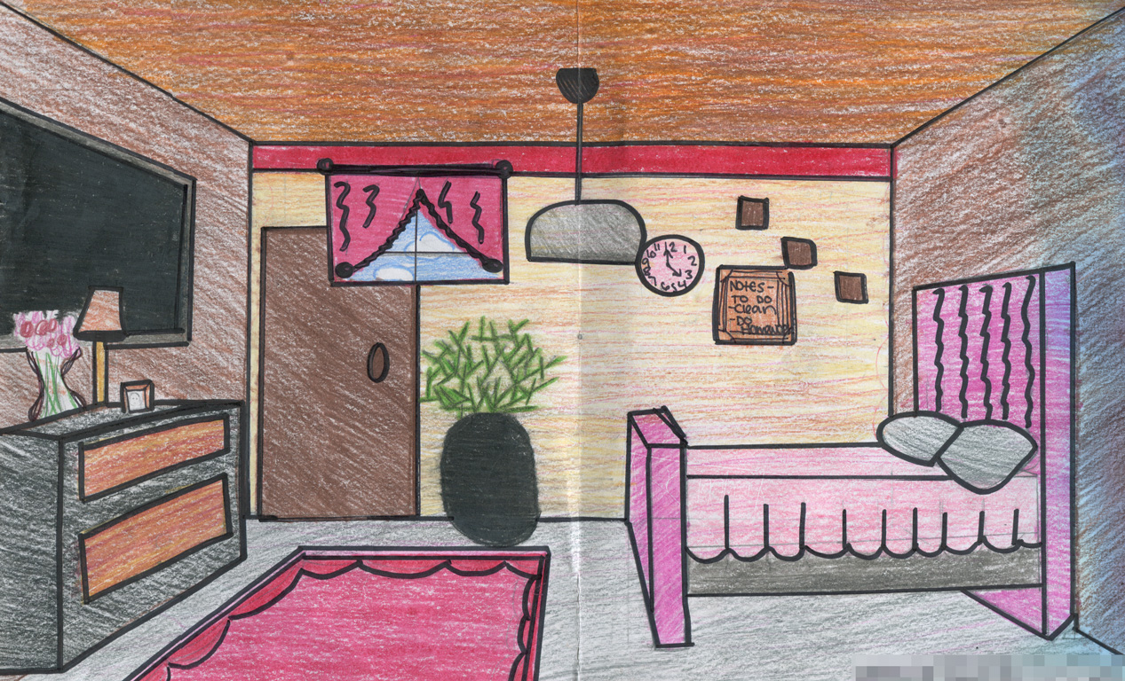
CSS

Slide 13

JS
JavaScript — это язык программирования
Позволяет страницу сделать динамической

Slide 14
Основные теги HTML

Slide 15
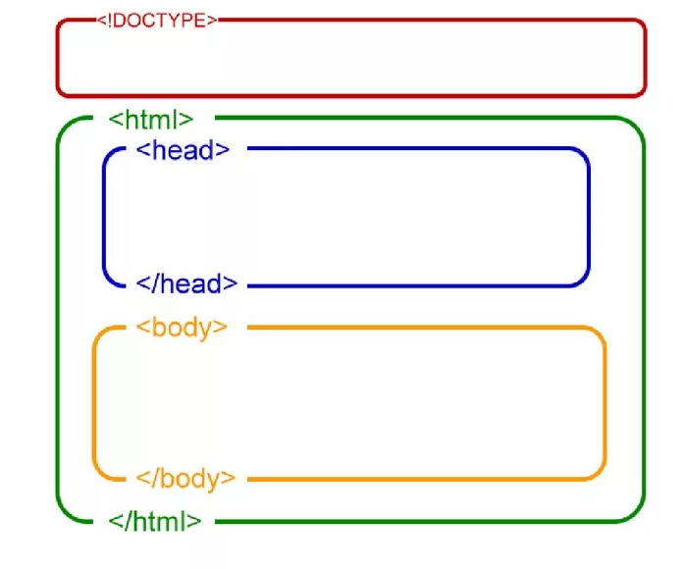
Структура HTML документа

Slide 16
Материал по HTML 5
http://uroki-html.ru/
http://uroki-html.ru/html5/index.php

Slide 17

Домашнее задание
Задачи 1-7
http://www.itmathrepetitor.ru/zadachi-po-html-i-css/

Slide 18
Домашнее задание 2
Добавить на страницу MP3 и MP4, а также реализовать задание
http://www.itmathrepetitor.ru/zadachi-po-html-i-css-zadacha-13-zapis-na-kursy/

Slide 19
Материал по CSS
http://uroki-css.ru/css/css_intro.php
http://htmlbook.ru/css

Slide 20
Домашнее задание 3

Slide 21
1. http://old.code.mu/tasks/css/osnovy-raboty-so-ssylkami-i-granicami-cherez-css-dlya-novichkov.html
2. http://old.code.mu/tasks/css/osnovy-raboty-s-fonom-cherez-css-dlya-novichkov.html
3. http://old.code.mu/tasks/css/rabota-s-otstupami-margin-i-padding-so-svojstvom-float-i-so-spiskami-na-css.html

Slide 22
4.

Slide 23
http://www.itmathrepetitor.ru/zadachi-po-html-i-css/

Slide 24
This is your presentation title

Slide 25
Instructions for use
EDIT IN GOOGLE SLIDES
Click on the button under the presentation preview that says "Use as Google Slides Theme".
You will get a copy of this document on your Google Drive and will be able to edit, add or delete slides.
You have to be signed in to your Google account.
EDIT IN POWERPOINT®
Click on the button under the presentation preview that says "Download as PowerPoint template". You will get a .pptx file that you can edit in PowerPoint.
Remember to download and install the fonts used in this presentation (you’ll find the links to the font files needed in the Presentation design slide)
More info on how to use this template at www.slidescarnival.com/help-use-presentation-template
This template is free to use under Creative Commons Attribution license. You can keep the Credits slide or mention SlidesCarnival and other resources used in a slide footer.

Slide 26
Hello!
I am Jayden Smith
I am here because I love to give presentations.
You can find me at @username

Slide 27
1.
Transition headline
Let’s start with the first set of slides

Slide 28
Quotations are commonly printed as a means of inspiration and to invoke philosophical thoughts from the reader.

Slide 29
This is a slide title
Here you have a list of items
And some text
But remember not to overload your slides with content
Your audience will listen to you or read the content, but won’t do both.

Slide 30
Big concept
Bring the attention of your audience over a key concept using icons or illustrations

Slide 31
You can also split your content
White
Is the color of milk and fresh snow, the color produced by the combination of all the colors of the visible spectrum.
Black
Is the color of coal, ebony, and of outer space. It is the darkest color, the result of the absence of or complete absorption of light.

Slide 32
In two or three columns
Yellow
Is the color of gold, butter and ripe lemons. In the spectrum of visible light, yellow is found between green and orange.
Blue
Is the colour of the clear sky and the deep sea. It is located between violet and green on the optical spectrum.
Red
Is the color of blood, and because of this it has historically been associated with sacrifice, danger and courage.

Slide 33
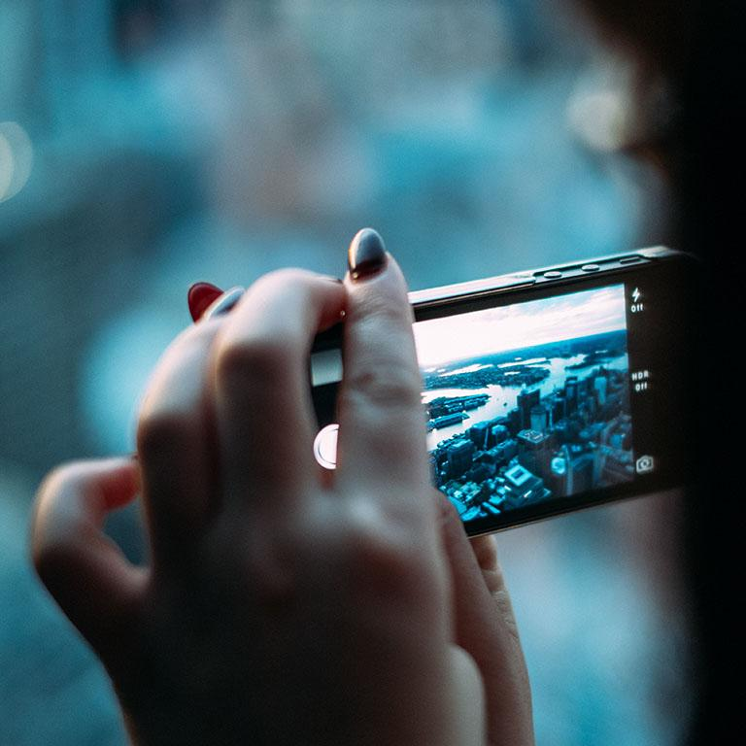
A picture is worth a thousand words
A complex idea can be conveyed with just a single still image, namely making it possible to absorb large amounts of data quickly.

Slide 34

Want big impact?
Use big image.

Slide 35
Use charts to explain your ideas
Yellow
Blue
Red

Slide 36
And tables to compare data
 | A | B | C
Yellow | 10 | 20 | 7
Blue | 30 | 15 | 10
Orange | 5 | 24 | 16

Slide 37
Maps
our office

Slide 38
89,526,124
Whoa! That’s a big number, aren’t you proud?

Slide 39
89,526,124$
185,244 users
100%
That’s a lot of money
And a lot of users
Total success!

Slide 40
Our process is easy
first
second
last

Slide 41
Let’s review some concepts
Yellow
Is the color of gold, butter and ripe lemons. In the spectrum of visible light, yellow is found between green and orange.
Blue
Is the colour of the clear sky and the deep sea. It is located between violet and green on the optical spectrum.
Red
Is the color of blood, and because of this it has historically been associated with sacrifice, danger and courage.
Yellow
Is the color of gold, butter and ripe lemons. In the spectrum of visible light, yellow is found between green and orange.
Blue
Is the colour of the clear sky and the deep sea. It is located between violet and green on the optical spectrum.
Red
Is the color of blood, and because of this it has historically been associated with sacrifice, danger and courage.

Slide 42
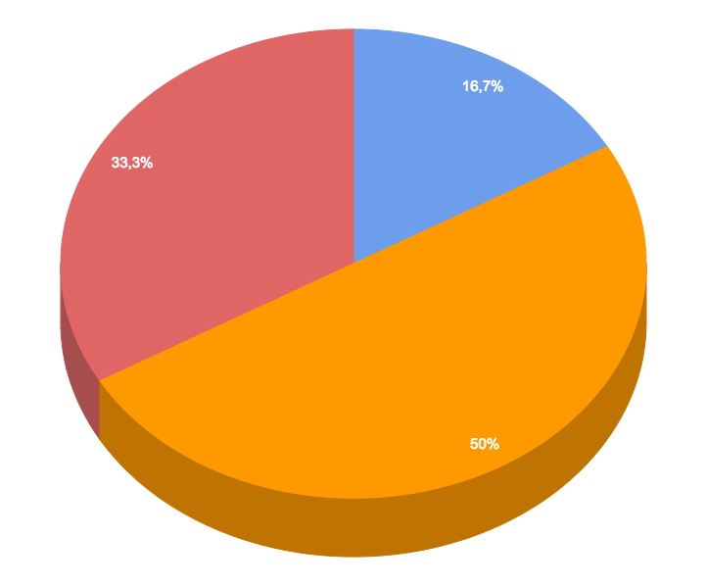
You can insert graphs from Google Sheets

Slide 43
Android project
Show and explain your web, app or software projects using these gadget templates.
Place your screenshot here

Slide 44
iPhone project
Show and explain your web, app or software projects using these gadget templates.
Place your screenshot here

Slide 45
Tablet project
Show and explain your web, app or software projects using these gadget templates.
Place your screenshot here

Slide 46
Desktop project
Show and explain your web, app or software projects using these gadget templates.
Place your screenshot here

Slide 47
Thanks!
Any questions?
You can find me at @username & user@mail.me

Slide 48
Credits
Special thanks to all the people who made and released these awesome resources for free:
Presentation template by SlidesCarnival
Photographs by Unsplash

Slide 49
Presentation design
This presentation uses the following typographies and colors:
Titles: Roboto Slab Light
Body copy: Lato Light
You can download the fonts on these pages:
http://www.latofonts.com/lato-free-fonts/
https://www.fontsquirrel.com/fonts/roboto-slab
Aqua #02bdc7 · Yellow #ffb600 · Magenta #fc4067
You don’t need to keep this slide in your presentation. It’s only here to serve you as a design guide if you need to create new slides or download the fonts to edit the presentation in PowerPoint®

Slide 50
SlidesCarnival icons are editable shapes.
This means that you can:
Resize them without losing quality.
Change line color, width and style.
Isn’t that nice? :)
Examples:

Slide 51
😉
Now you can use any emoji as an icon!
And of course it resizes without losing quality and you can change the color.
How? Follow Google instructions https://twitter.com/googledocs/status/730087240156643328
✋👆👉👍👤👦👧👨👩👪💃🏃💑❤😂😉😋😒😭👶😸🐟🍒🍔💣📌📖🔨🎃🎈🎨🏈🏰🌏🔌🔑 and many more...

